Slide 1


Data Governance @ SneakerPark
Prepared by: Pranav Arya
Submitted on: 24/12/2025

Slide 2
Background
SneakerPark is an online shoe reseller that allows people to buy and sell used and new shoes. Buyers can bid for shoes or buy them outright, and sellers can set a price or sell to the highest bidder.
Each buyer and seller must have an active account in order to sell, bid, or purchase sneakers using SneakerPark’s website.
SneakerPark authenticates the shoes before shipping them to the buyer, so before listing an item, the seller must ship it to SneakerPark’s warehouse. Upon receipt, SneakerPark assigns an item number to each pair of sneakers and notifies the seller that they are now free to list their item. If the item is not listed within 45 days, SneakerPark returns it to the seller and sends an invoice to the seller for the shipping cost.
If the item is found to be inauthentic or in an unacceptable condition, it is also returned back to the seller in a similar fashion.
When the item sells, the buyer’s account is credited with the purchase price minus the SneakerPark service fee and shipping fees to deliver the item to the buyer.
Currently, SneakerPark only supports sales within the United States.

Slide 3
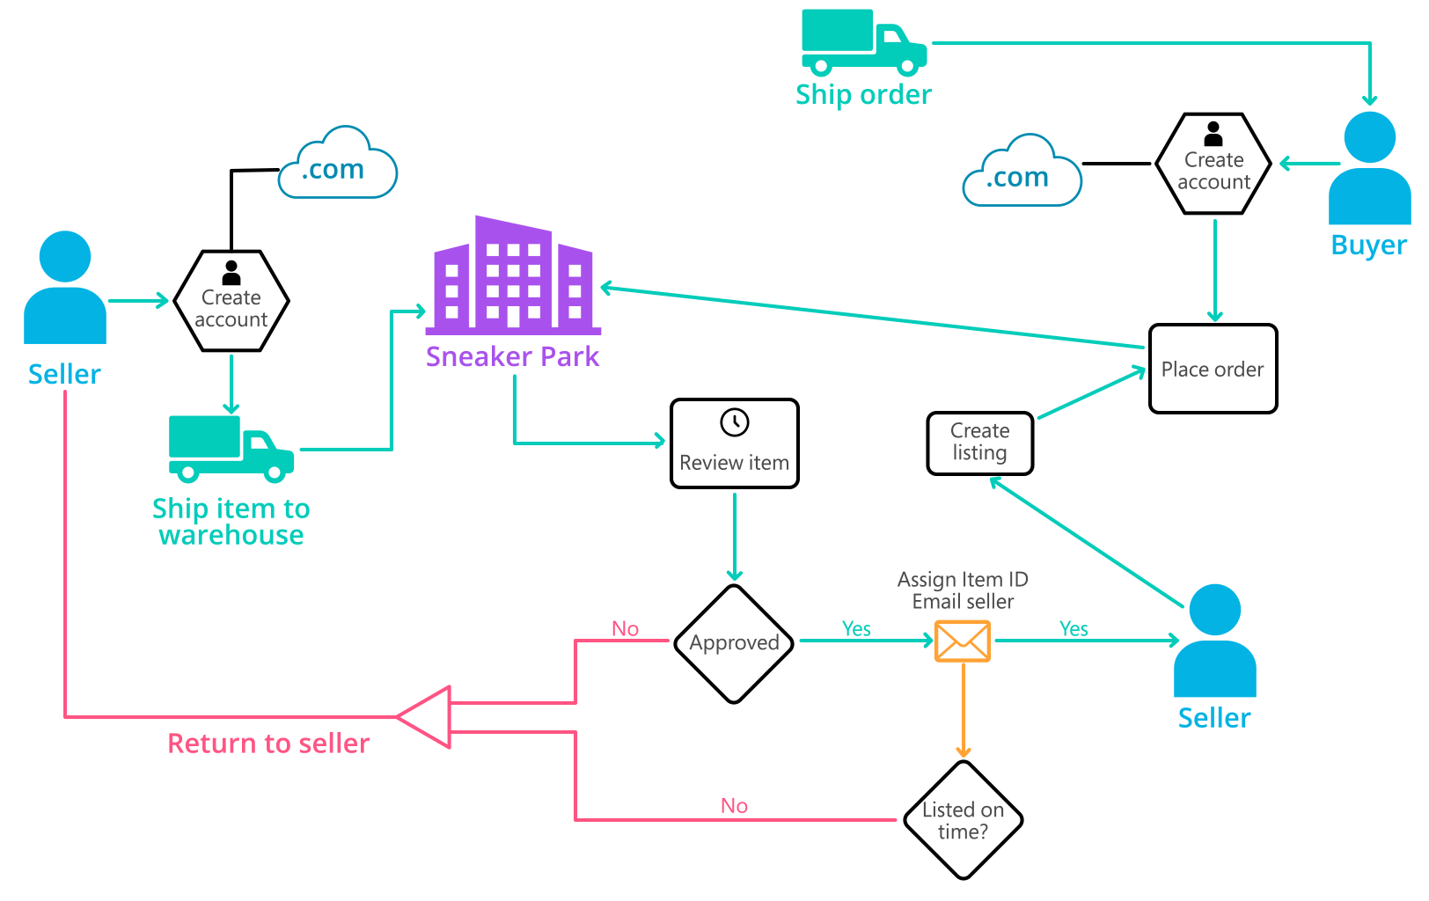
Background (cont’d)
Below you can see a diagram that will hopefully help you visualize some of SneakerPark's business processes. Keep in mind that it does not capture ALL processes and every nuance, but simply serves as another artifact to use in your project.

Slide 4
Step 1
Enterprise Data Catalog Part 1: Enterprise Data Model

Slide 5
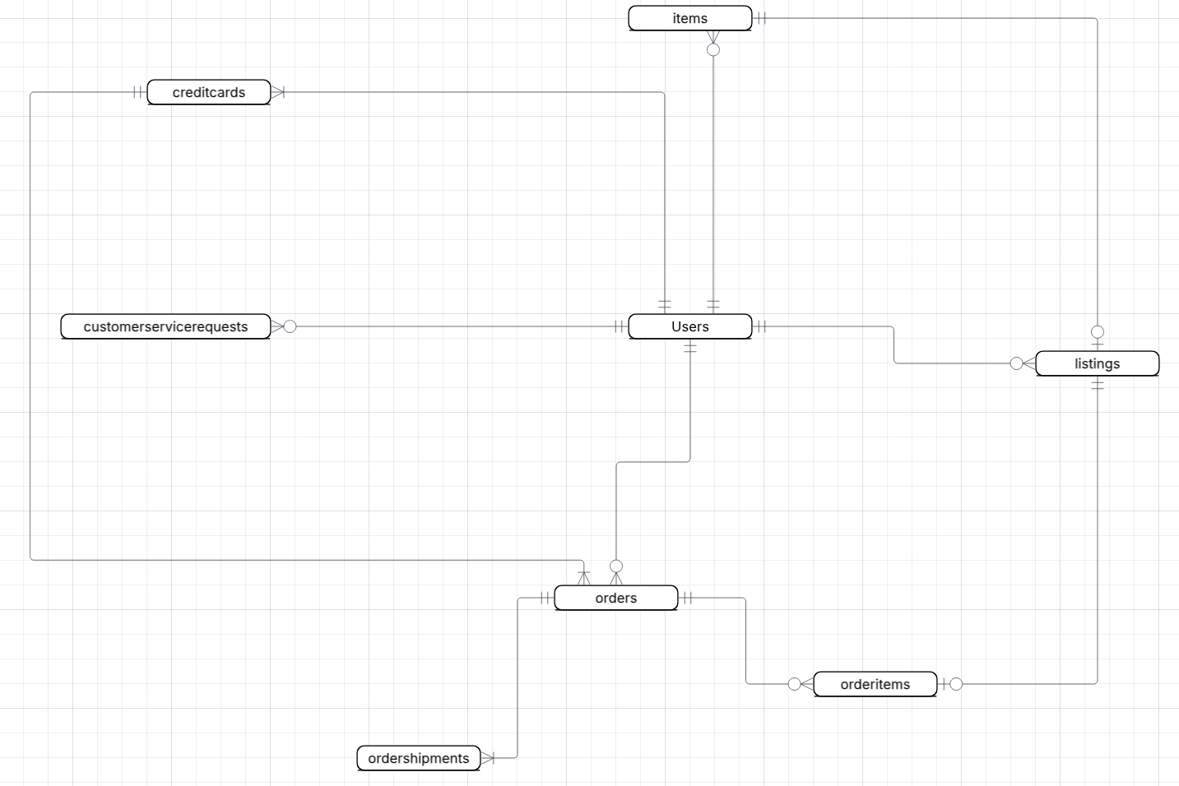
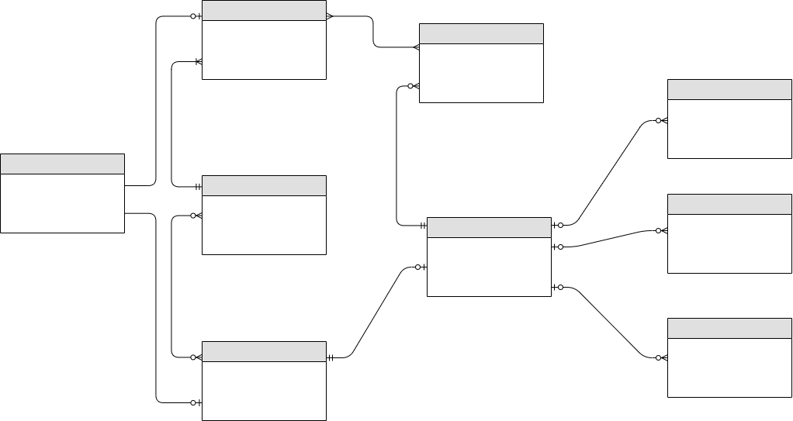
Conceptual data model that provide sSneakerPark with a holistic view of its data systems and help grasp the organization's important entities and relationships

Slide 6
Step 2
Enterprise Data Catalog Part 2: Metadata

Slide 7
Create the first version of the Metadata Catalog by documenting the metadata from all systems in the "Data Dictionary" and the “Enterprise Data Catalog” tabs of the provided Sheets template.
Please note that you are required to fill out all fields in both tabs.
SEE EXCEL FILE

Slide 8
Step 3
Data Quality
Part 1: Profiling and Cleansing

Slide 9
Profile the data to identify at least 3 data quality issues you see in the data. Also provide at least 1 data quality issue that you haven’t yet seen in the data, but can foresee occurring in the future. Based on the issues you’ve identified, come up with the data quality rule for each data quality issue, including for the one that you foresee.
Make sure you fill out all columns in the "Data Quality Issues" tab with your answers in the provided Sheets template.
SEE EXCEL FILE

Slide 10
Step 4
Data Quality
Part 2: Monitoring

Slide 11
Mock-up of a data quality monitoring dashboard that will be used to monitor the data to ensure compliance with data quality rules.

Slide 12
Step 5
Master Data Management
Part 1: MDM Architecture

Slide 13
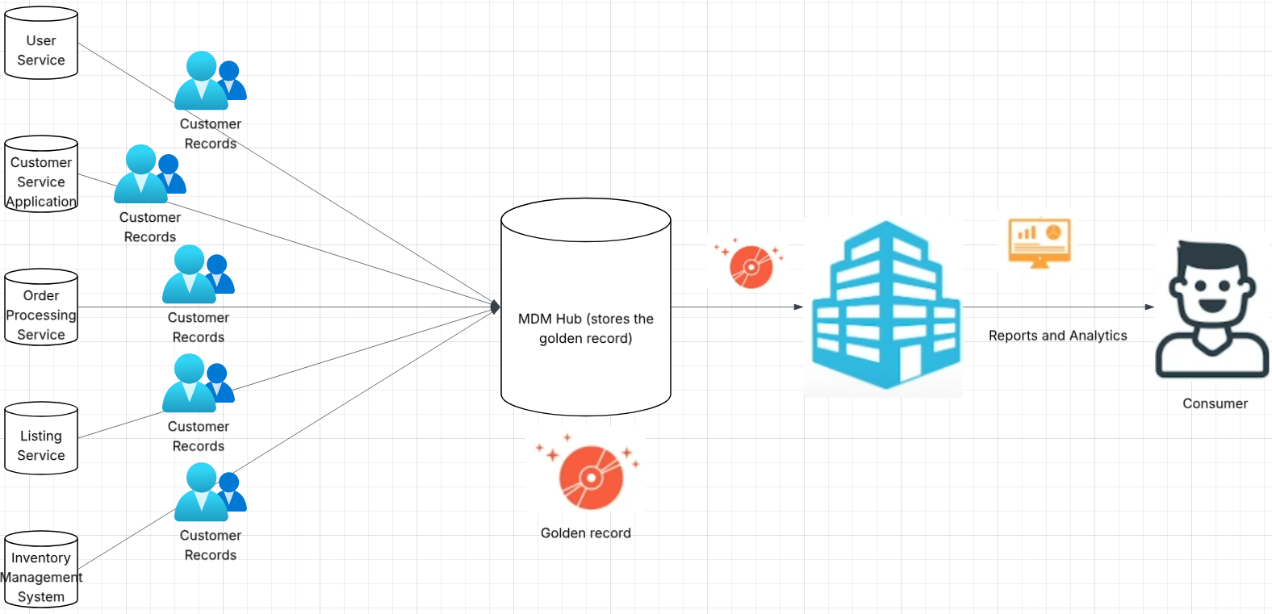
Proposed MDM implementation architecture

Slide 14
Explanation:
SneakerPark operates several operational systems that create and manage their own master data. The proposed Consolidated MDM architecture for SneakerPark consists of multiple source systems, which act as the systems of record where master data is created and maintained. It avoids disrupting existing business processes or ownership models. This will allow SneakerPark to improve data quality and visibility without forcing changes to how source systems create or update data.
Master data from these source systems is extracted on a scheduled batch basis where the data is loaded into a centralised MDM Hub. Consolidate MDM is suited to this, because it balances improved data quality with moderate implementation complexity and cost.
The MDM Hub stores consolidated master data as golden records for key entities such as customers, listings, and orders, and applies data quality rules to ensure consistency and accuracy. The golden records in a centralized MDM Hub addresses the challenges with duplicate, inconsistent and incomplete data across system, producing a single, authoritative version of master data, improving data accuracy and consistency for reporting and customer analysis without requiring centralized control over data creation.
The mastered data then flows one way from the MDM Hub to downstream consumers, including reporting and analytics dashboards and a future Enterprise Data Warehouse planned for Phase 2, providing a trusted view of master data without writing changes back to the operational source systems and with minimal impact on existing systems.

Slide 15
Step 6
Master Data Management
Part 2: Master Record

Slide 16
Matching rules that will be used by the SneakerPark's MDM Hub to match item and customer entities between the company's different systems.
Items:
Item ID Rule – Match item records between the Inventory Management System and other systems via itemid and itemname, present in inventory management system. Can also use sellerid, which is present in the listings table.
Product Attribute Rule – Match item records from the items table in inventory management system to listings table in listing service. Product attributes are in the columns: color, size, and condition. There are also common columns but with different names, between tables listings/items, including shoetype/type, brand/brandname, gender/sex.
Customer:
User ID Rule - Match customer records using userid across tables users, customer service requests, creditcards. In the table orders, userid is buyerid in the Ordering System. This identifier is shared across systems and thus is good for matching customers
Name and Email Rule – Match customer records using a combination of first name, last name and email address. Good for customer matching when userid has inconsistencies and is unable to match/user id not available. Email is good to use if different users have same first and ast name. Useful for User Service systems and Customer Service Application systems; these have tables with all 3 columns

Slide 17
Step 7
Data Governance:
Roles and Responsibilities

Slide 18
Several new data governance roles will be necessary.
For Data Quality Management, dedicated Data Stewards should be appointed for each critical data domain (Customers, Orders, Inventory, and Listings). These stewards will be responsible for monitoring data quality, implementing validation rules, performing data cleansing, and ensure accuracy, completeness and consistency in the master data. They may also address systemic data issues and ensure data quality standards are met.
For Metadata Management, a Metadata Manager and/or colleagues within the manager's team, should maintain and extend the Enterprise Data Catalog, documenting all entities, attributes, relationships, and business rules. This ensures metadata accuracy, updating business glossaries, and supporting both technical and operational metadata creation by IT personnel.
For Master Data Management (MDM), a Master Data Owner or MDM steward will oversee the creation and maintenance of golden records, define and review matching rules, approve or reject matched records, and handle exceptions to ensure consistent master data across source systems.
Currently, SneakerPark’s team consists of a senior business analyst and an IT support resource. It is recommended that the company hire additional personnel with the necessary skills and provide them responsibilities to oversee this new Data Management initiative, such as data stewards, data administrators, and additional technical. These new hires will provide the necessary expertise to allow for good data governance processes across SneakerPark

